Slide 1
Advanced Data Science Capstone IBM
Ammar Shaheen
3 Dec 2022

Slide 2
OUTLINES
Dataset - Use case
Data exploration
Data cleansing - Data aggregation
Model definition and training
Model evaluation
Hyperparameters tuning

Slide 3
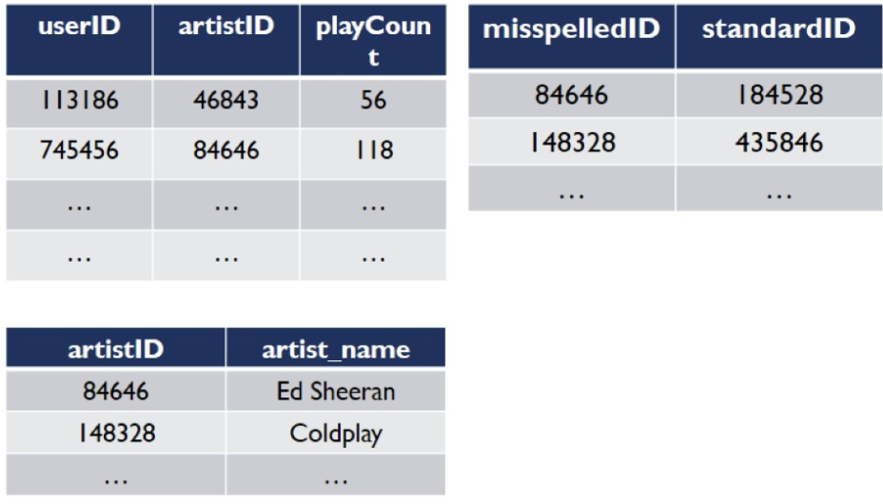
DATASET
Dataset published by
Audioscrobbler - a music recommendation system for last.fm
Contains:
140.000 unique users
1.6 million unique artists

Slide 4
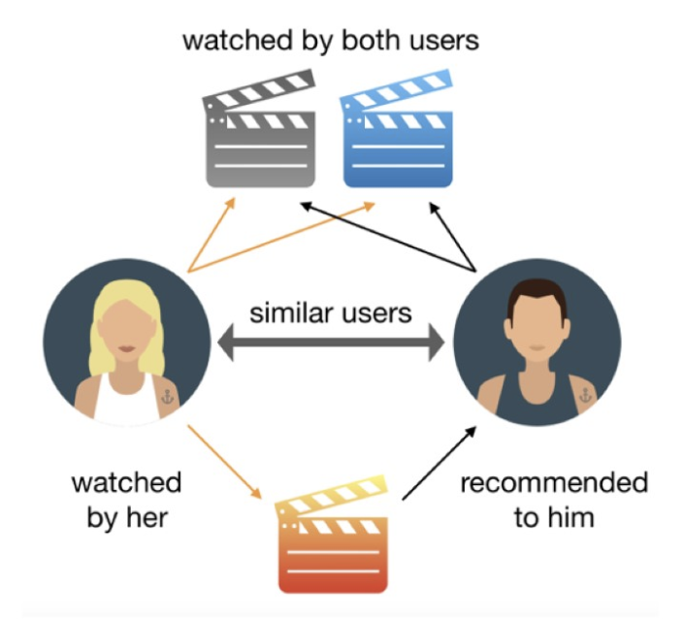
USE CASE
Develop music
Recommendation system

Slide 5
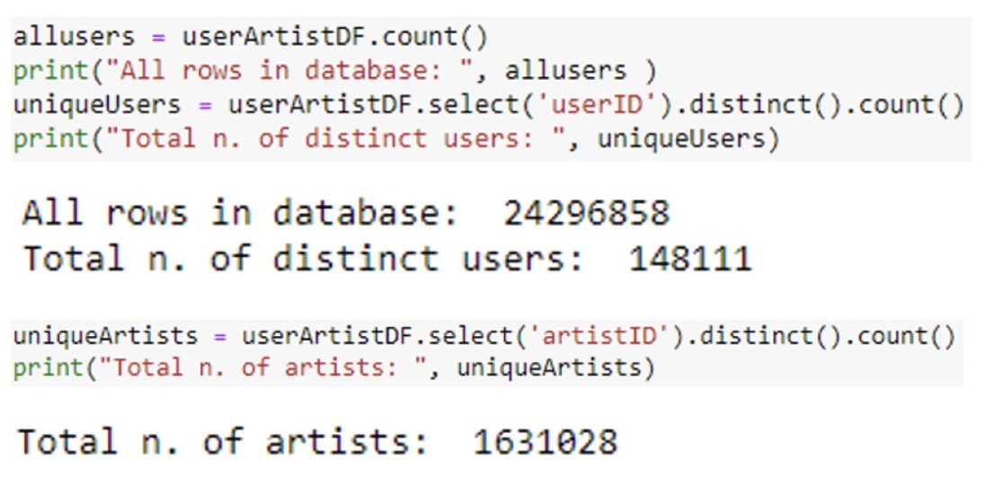
DATA EXPLORATION

Slide 6
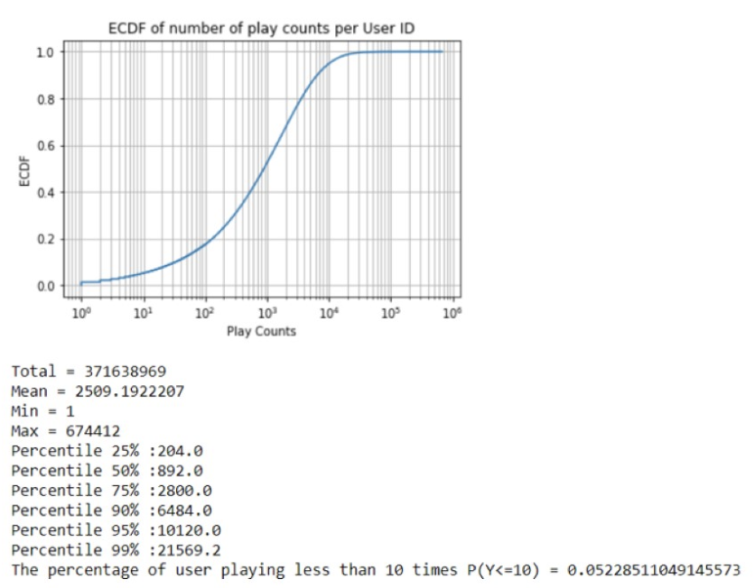
DATA EXPLORATION
A user played 2509 times on average
50% of the users have the play counts less than or equal to 892 times.
75% of the users have the play counts less than or equal to 2800 times.
95% of the users have the play counts less than or equal to 10120 times.
About 7746 users (5.23%) have the play counts less than or equal to 10 times
These users have very little interaction with the system, so there is more difficult for recommending for these users.

Slide 7
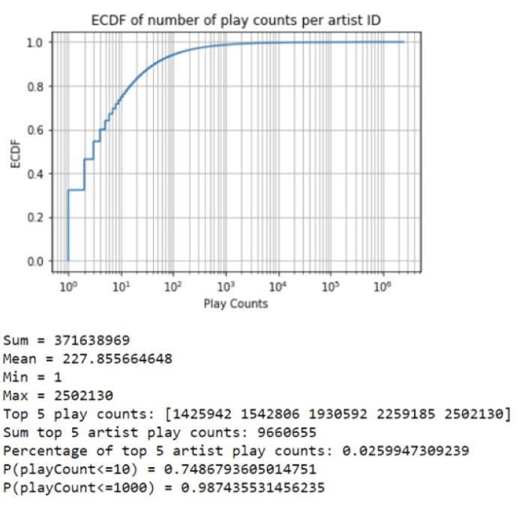
DATA EXPLORATION
In average, play count per artist is 227 times
Only 74.87% of the artists is played less than or equal to 10 times.
And 98.74% of the artists is played less than or equal to 1000 times.
Top 5 artists play counts: 1425942 1542806 1930592 2259185 2502130.
These accounts for 2.6% on overall number of playCount. Moreover, the play count of top 5 is much higher than the mean. So we can infer that we can recommend most played artists to every user with this stop 5 artists. And still get high performance.

Slide 8
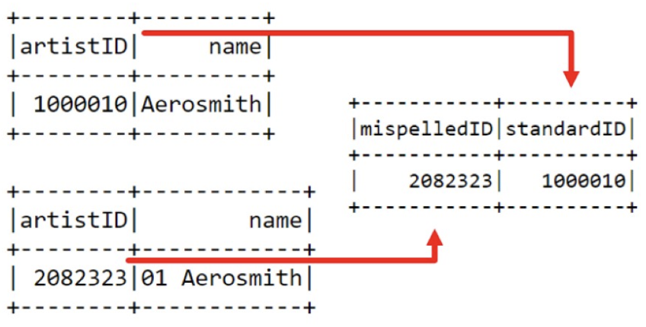
DATA CLEANSING
Same artists but different IDs =>
Solved: Replace misspelledID by standardID

Slide 9
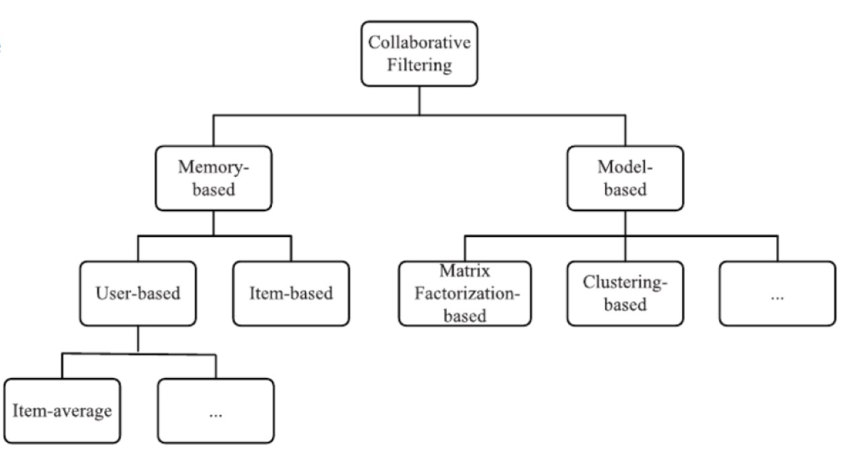
MODEL DEFINITION
Collaborative Filtering

Slide 10
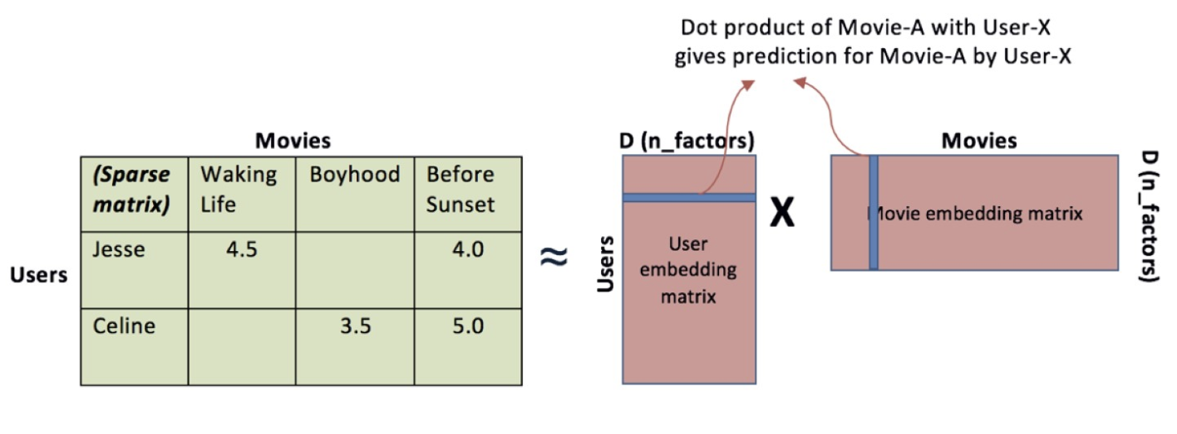
MODEL DEFINITION
Matrix Factorisation

Slide 11
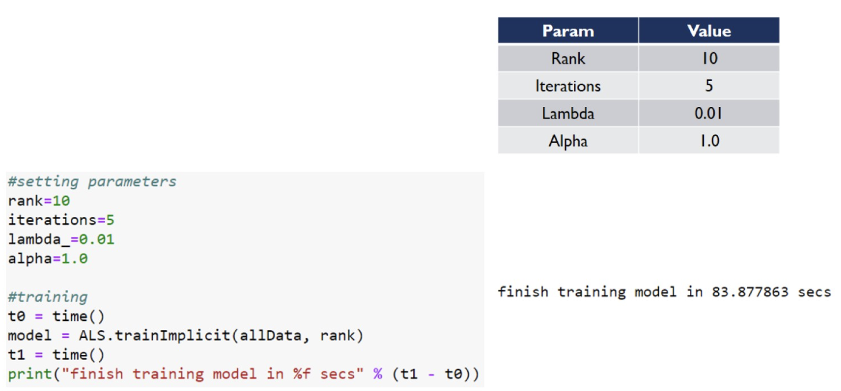
MODEL TRAINING
A model can be trained by using ALS.trainlmplicit(<training data>,<rank>)
Split data to 70% for training and 30% for testing
We can also use some additional parameters to adjust the quality of the model. Currently, let’s see:

Slide 12
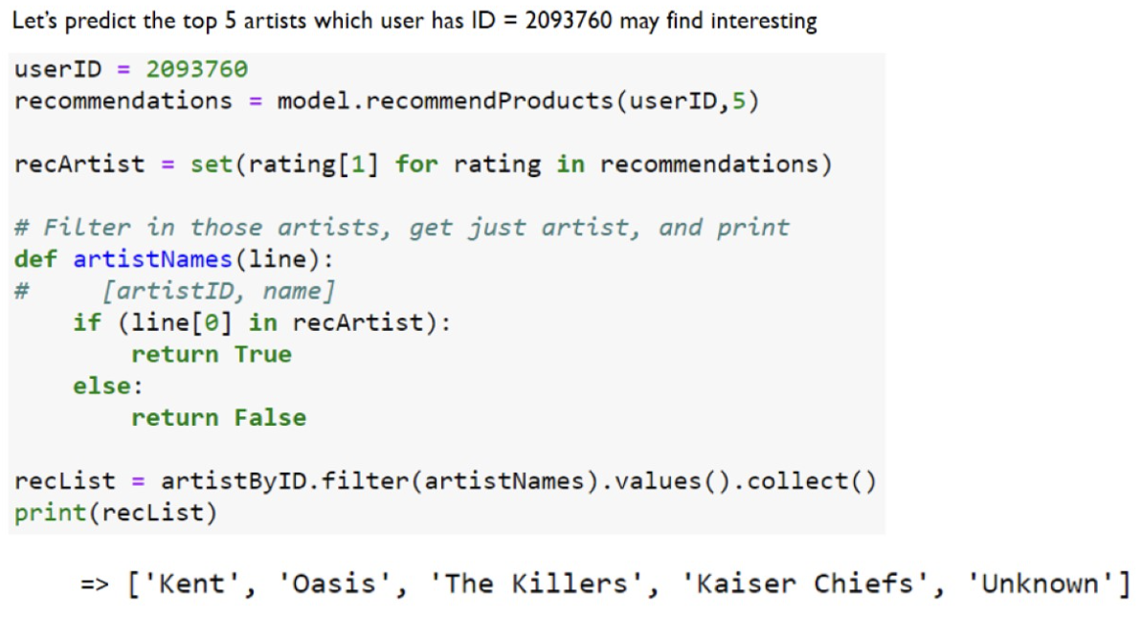
MODEL TRAINING

Slide 13
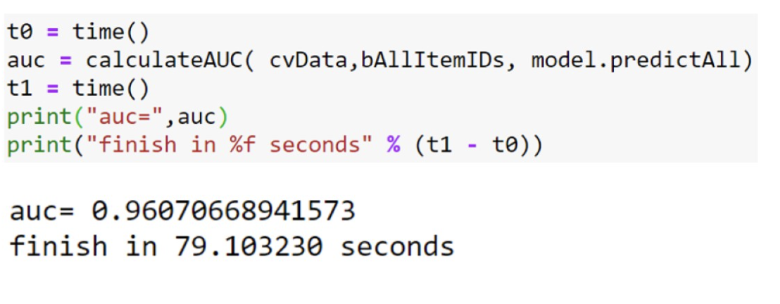
MODEL EVALUATION

Slide 14
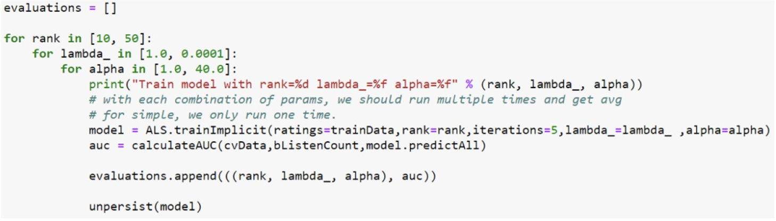
HYPERPARAMETER TUNING

Slide 15
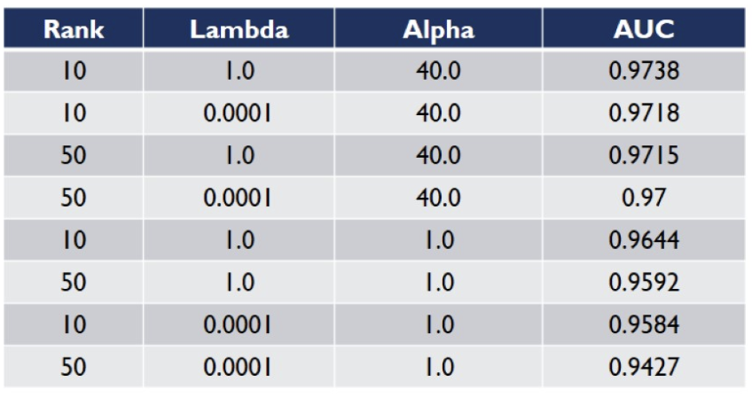
HYPERPARAMETER TUNING
Grid search
The model with the largest AUC score has the combination of Rank = 10.Lambda = 1.0 and Alpha = 40.0

Slide 16
CONCLUSION
The model is highly biased on the artists who have large number of play counts
We may not need to include lambda and alpha parameters to the model if we only retrieve the top result less than 10 artists.

